Slide 1
British Airways
Customer ratings analysis and insights
by abdelouahab el bechraoui
Friday, September 20, 2024

Slide 2
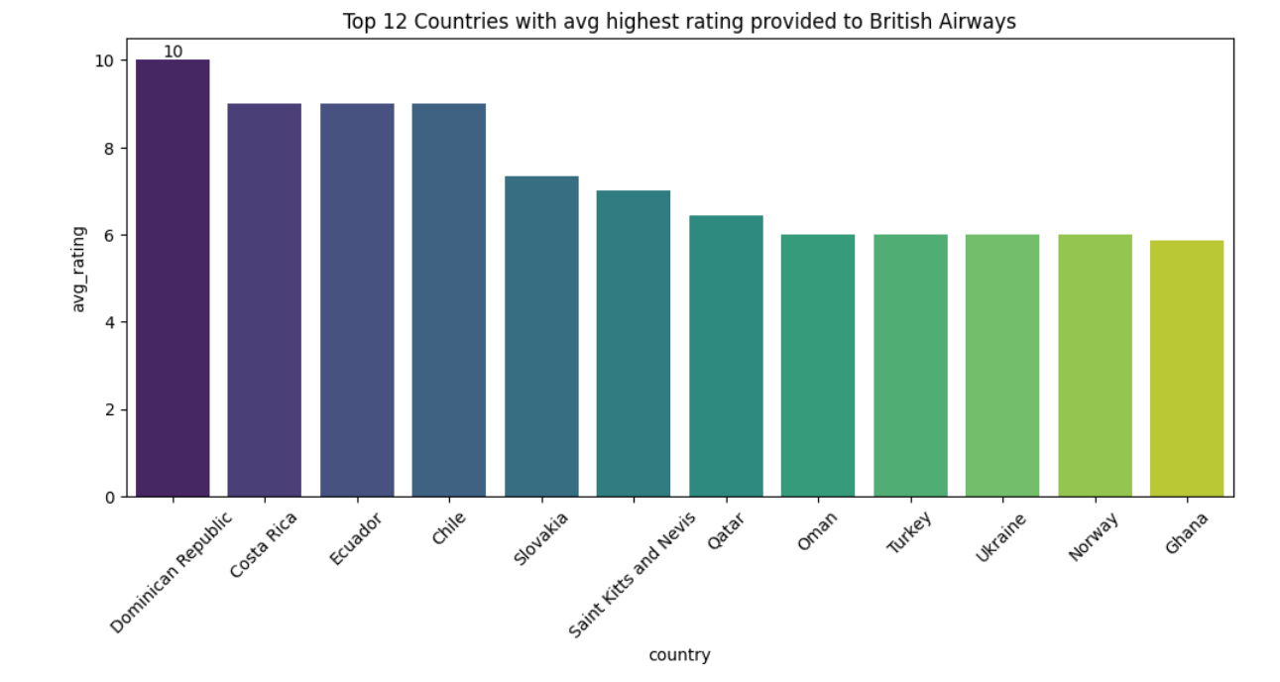

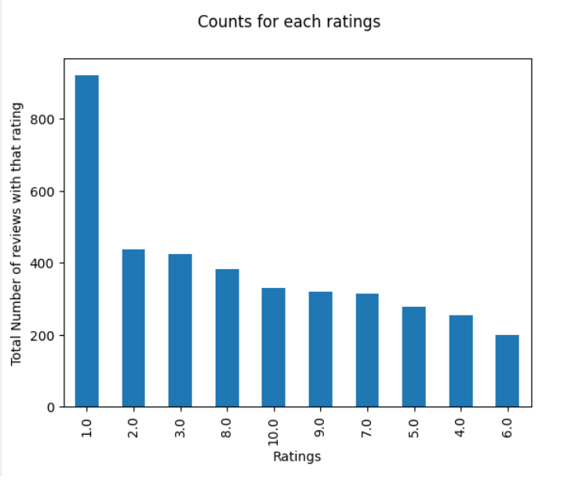
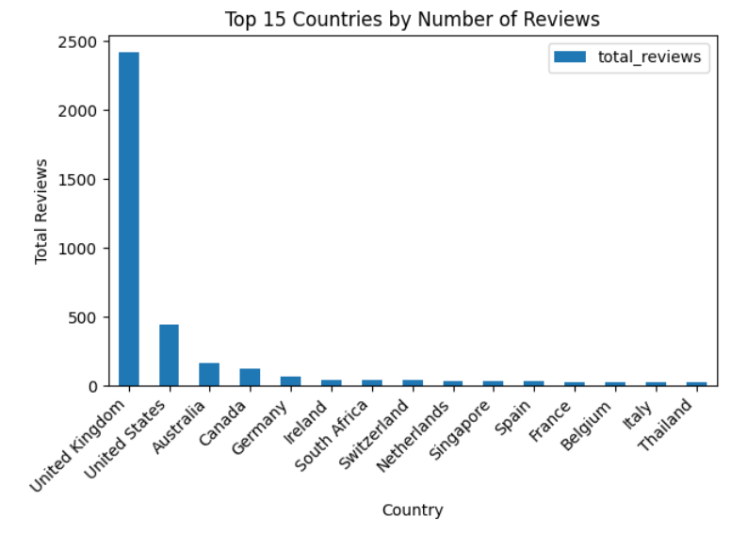
All Customers liked Cabin crew service and staff, general economy seats. Many travelled in Business class.
Focus on – Economy class service, seats, enhance inflight entertainment experience and importantly Delays. Enhance the experience of business class, it seems customers want value for money. Improve Customer service on refund requests and process.
Average Overall Rating
Reviews from 73 Countries
3859 reviews
collected
4.68 / 10

